Slide 1

Co-created Courseware Project
Nextbook

Slide 2
Co-created Interactive CoursewarE
A social learning environment
Students help each other learn
Track their own progress
Co-creation of interactive textbooks
Learning analytics

Slide 3
Co-created Interactive CoursewarE
There is significant evidence that dialogic and socially constructive pedagogical strategies, even asynchronous ones, support student learning (e.g. Abuhassna et al., 2020; Narang, Yadav & Rindfleisch, 2022).

Slide 4

Co-created Interactive CoursewarE
Co-creation as an “enactment of creation through interactions”
Ramaswamy & Ozcan, 2018, p196

Slide 5
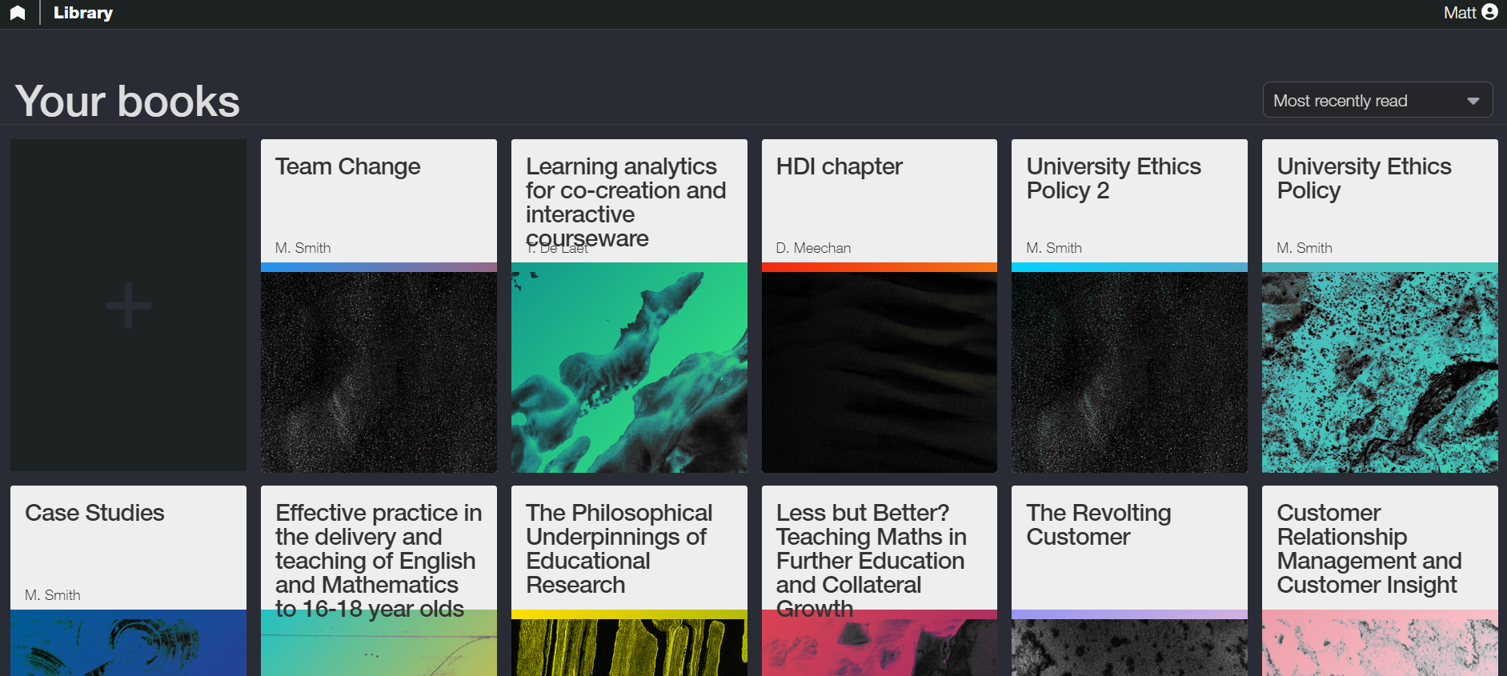
Co-created Interactive CoursewarE
The platform
What do students get?
What do YOU get?

