Slide 1
Interactive courseware to connect discussion to course material: so what?
Matt Smith & Howard Scott
University of
Wolverhampton, UK
(Tinne De Laet)
(KU Leuven, Belgium)

Slide 2
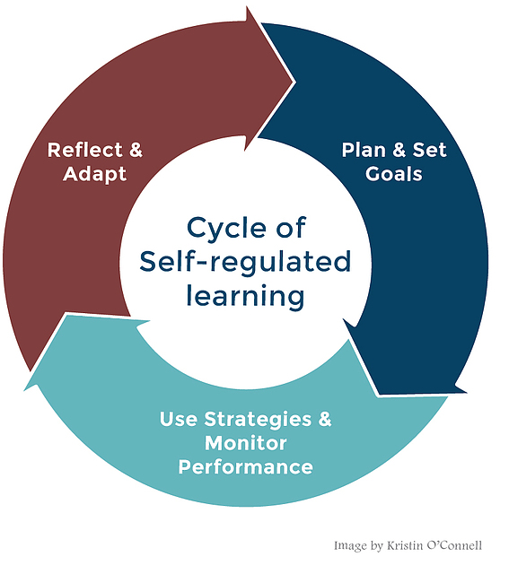
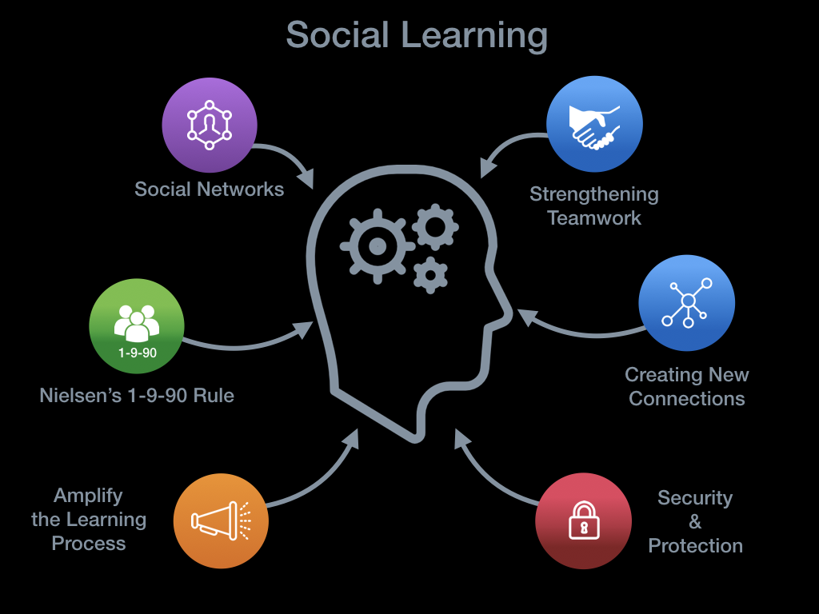
Need?
Course material
Asynchronous ↨ Social
Learning?

Slide 3
Platform for Next-generation textbooKS
Nextbook platform (www.nextbook.be)
“Next-generation” textbooks
Interactivity:
Content
Other learners
Teachers
Social learning environment
Demonstration:
https://nextbook.io/book/sample-course

Slide 4
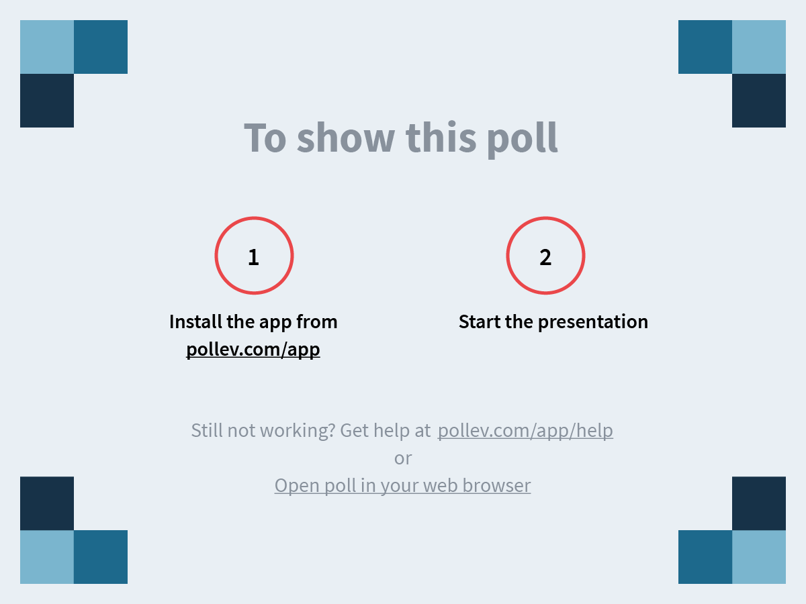
PollEv.com/mattsmith609
Notes:
What are possible affordances? https://www.polleverywhere.com/free_text_polls/1oQv67xXrYGVp9UIbKLZF

Slide 5
Affordances & Theoretical underpinning
Affordances
Theoretical underpinning
Collaboration
Creativity
Self-directed learning
Personalized resources
dialogic practice
heutagogy (self-determined learning)
student empowerment
nurturing agency in students

Slide 6
“NORMAL” TEACHING context
Flipped teaching
big classroom - theory
exercise sessions

Slide 7
“FLIPPED” TEACHING context
Interactive lecture with Q&A and discussions
Individual/group study outside the classroom

Slide 8
Case study context
Flipped teaching
Interactive lecture with Q&A and discussions

Slide 9
PollEv.com/mattsmith609
Notes:
Which potential pedagogical use cases do you envision? https://www.polleverywhere.com/free_text_polls/FuJyspdMJtkRDdqsDmBYl

Slide 10
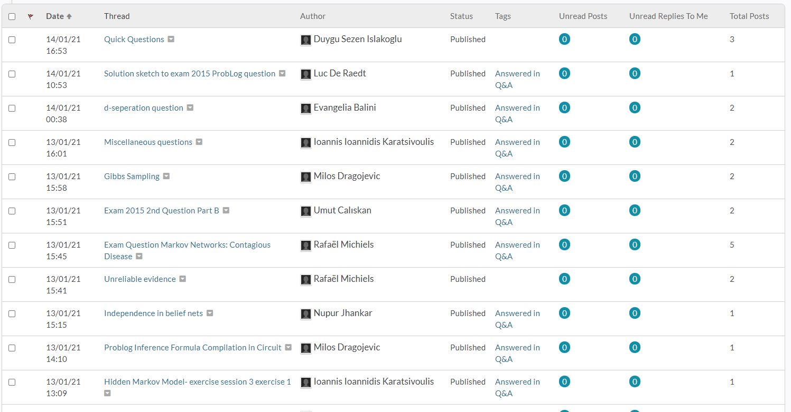
Case study - issue
Students' questions and discussions on the “discussion platform” are not connected to the course material
Result:
No “overview” of the questions and answers (students and teachers)
Students do not spot interesting Q&A or discussion when they are studying the content
Students ask similar questions multiple times

Slide 11
Case study – asynchronous discussion in nextbook

Slide 12
Case study findings
Positive
To be improved
Integration with LMS
Students see questions and discussion already when viewing material
Fewer duplicate questions
As teacher: easier to get overview of difficult parts to be discussed in interactive session or points for improvement of material
Which questions are new?
Analytics: how/when are students using the platform

Slide 13
Towards useful analytics
meaningful learning
traces
answer pedagogical questions

Slide 14
AN Opportunity for COURSE TUTORS
Use Nextbook for free for your pedagogical use cases and on your courses!
Interested?
Matt.Smith@wlv.ac.uk
Howard.Scott@wlv.ac.uk
Tinne.DeLaet@kuleuven.be
Or leave your contact information in the chat!

Slide 15
Thanks!
Matt.Smith@wlv.ac.uk
Howard.Scott@wlv.ac.uk
Tinne.DeLaet@kuleuven.be
2019-1-UK01-KA203-061669 The European Commission is not responsible for the content of this publication

